Slide 1
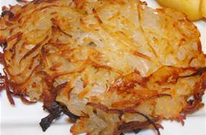
COMP 53 – Week Eleven
Hashtables

Slide 2
What We’ve Covered So Far
Data Structures
Linear
Direct Access
Sequential Access
Nonlinear
Hierarchical
Array
List
Stack
Queue
Hashtable
Tree
Heap

Slide 3
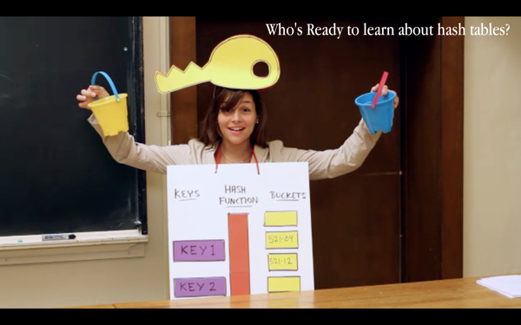
Topics
Hash Table Concepts
CRUD Operations
Hash Algorithms

Slide 4
Why Do We Care
More efficiency to access data elements
Attempts to maximize space-time continuum
Related to security and data encryption

Slide 5
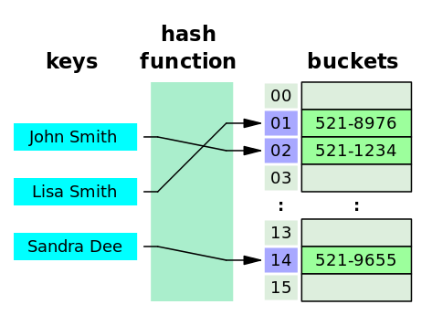
Hash Tables
A hash table or hash map is a data structure that efficiently stores and retrieves data from memory
Typically implemented as a hash table that uses an array in combination with singly linked lists
Uses a hash function
Maps an object to a key
For example, a string to an integer

Slide 6
Hash Table Concept
Storage Model
Make an array of fixed size, say 10
Each array element is a linked list
Create (add item to table), Update
Map (i.e. hash) it to one of the 10 array elements
Add or Update the linked list at that location
Read (Retrieve)
Determine its hash code then search the linked list at the corresponding array slot for the item

Slide 7
Simple Hash Function for Strings
int computeHash(string s)
{
int hash = 0;
for (int i = 0; i < s.length( ); i++)
{
hash = hash + s[i];
}
return hash % SIZE; // SIZE = 10 in example
}
Example: "dog" = ASCII 100, 111, 103
Hash = (100 + 111 + 103) % 10 = 4
Sum the ASCII value of every character in the string and then compute the modulus of the sum using the size of the fixed array
Other models include basic division or midsquare (square of the key and select middle bits)

Slide 8
Hash Table Practice 1 of 3
Open up your existing linked list practice project
Create a new class for the hash table
Private Properties
Node<T>* table[SIZE];
int hash(string s);
Methods
Private : hash(string s)

Slide 9
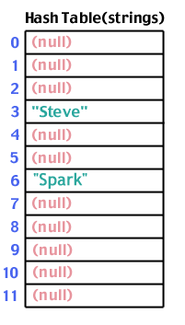
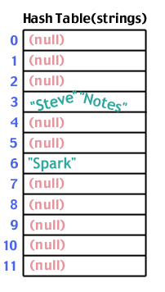
Hash Table Collisions
These values map to different array locations
But sum of “Steve” = sum of “Notes”

Slide 10
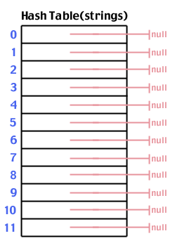
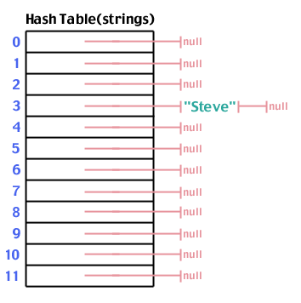
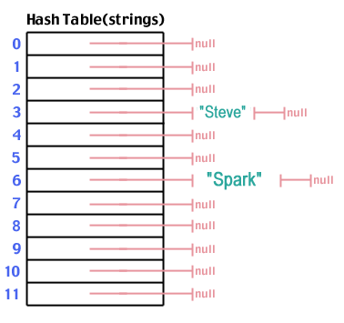
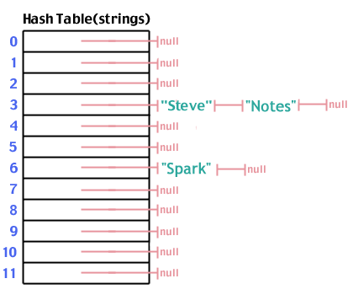
Adding Hash Table Elements
Insert new element as head of list
Insert node with collision after the head

Slide 11
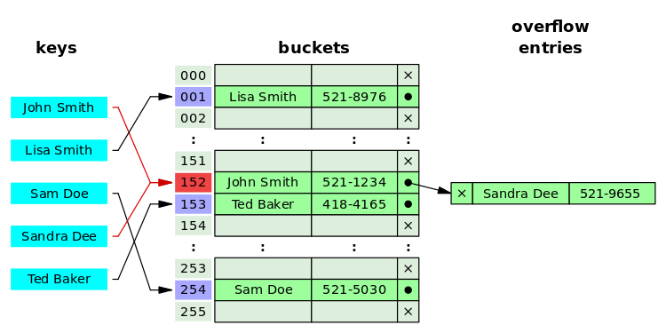

Slide 12
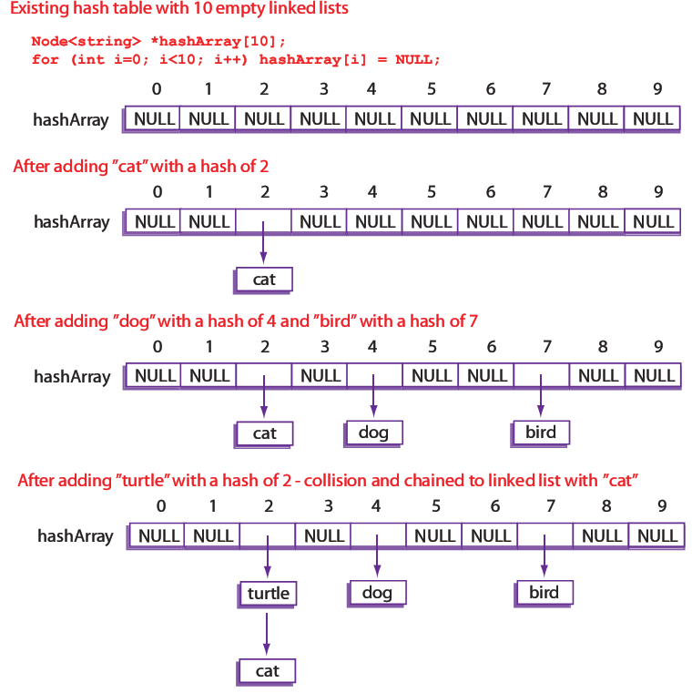
Constructing a Hash Table

Slide 13
Hash Table Practice 2 of 3
Add methods to insert and print out the hash table
Methods
Public : insert(string key, T item)
Public : print()

Slide 14
Hash Table Efficiency
Worst Case – O(n)
Every item inserted into the table has the same hash key
Find operation may have to search through all items every time
Best Case – O(1)
Every item inserted into the table has a different hash key
Find operation will only have to search a list of size 1
Can decrease the chance of collisions with a better hash function
Tradeoff: Lower chance of collision with bigger hash table, but more wasted memory space

Slide 15
Collisions Chaining Option
[0]
[1]
[2]
[3]
[4]
[5]
[6]
[7]
Bob
And
Car

Slide 16
Collision Linear Probe Option
[0]
[1]
[2]
[3]
[4]
[5]
[6]
[7]
Bob
And
Car

Slide 17
Hash Table Practice 3 of 3
Add methods to search and remove items
Methods
Public : search(string key, T item)
Public : remove(string key, T item)

Slide 18
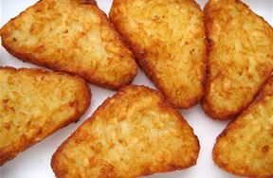

Other Hash Table Algorithms
Random number generation to identify the key
Double hash – Similar to chaining, but second algorithm determine the “jump” distance.
2-Choice Hash – Two algorithms. If hash One collides, use hash Two. If both collide, choose the hash with lowest number of items.
+ many others

Slide 19
Key Takeaways
Unique blend of data structures – arrays and linked lists
Balanced combination of search and insertion operations

